Slide 2
Low-level plotting functions
Low-level plotting functions allow you to add elements, like points, or lines, to an existing plot. Here are the most common low-level plotting functions:
Table 11.8: Common low-level plotting functions.
Function | Outcome
points(x, y) | Adds points
abline(), segments() | Adds lines or segments
arrows() | Adds arrows
curve() | Adds a curve representing a function
rect(),polygon() | Adds a rectangle or arbitrary shape
text(), mtext() | Adds text within the plot, or to plot margins
legend() | Adds a legend
axis() | Adds an axis

Slide 3
locator: Graphical Input
Description
Reads the position of the graphics cursor when the (first) mouse button is pressed.
Usage
locator(n = 512, type = "n", …)
Arguments
n -the maximum number of points to locate. Valid values start at 1.
type -One of "n", "p", "l" or "o". If "p" or "o" the points are plotted; if "l" or "o" they are joined by lines.
…
additional graphics parameters used if type != "n" for plotting the locations.

Slide 4
identify reads the position of the graphics pointer when the (first) mouse button is pressed. It then searches the coordinates given in x and y for the point closest to the pointer. If this point is close enough to the pointer, its index will be returned as part of the value of the call.
identify(x, ...)
identify(x, y = NULL, labels = seq_along(x), pos = FALSE,
n = length(x), plot = TRUE, atpen = FALSE, offset = 0.5,
tolerance = 0.25, order = FALSE, ...)
x, y - coordinates of points in a scatter plot. Alternatively, any object which defines coordinates (a plotting structure, time series etc: see xy.coords) can be given as x, and y left missing.
labels - an optional character vector giving labels for the points.
pos -if pos is TRUE, a component is added to the return value which indicates where text was plotted relative to each identified point: see Value.
n - the maximum number of points to be identified.
plot -logical: if plot is TRUE, the labels are printed near the points and if FALSE they are omitted.

Slide 5
atpen - logical: if TRUE and plot = TRUE, the lower-left corners of the labels are plotted at the points clicked rather than relative to the points.
offset -the distance (in character widths) which separates the label from identified points. Negative values are allowed. Not used if atpen = TRUE.
Tolerance-the maximal distance (in inches) for the pointer to be ‘close enough’ to a point.
order -if order is TRUE, a component is added to the return value which indicates the order in which points were identified: see Value.
...
further arguments passed to par such as cex, col and font.

Slide 6
What is Lattice?
A lattice in R is known for its robust, elegant and aesthetic data visualisation system. That is, being inspired by Trellis graphics. Although, it is designed with an emphasis on multivariate data which allows easy conditioning to produce “small multiple” plots.
1. Lattice Graphs
provides the ability to display multivariate relationships and it improves on the base-R graphics. This package supports the creation of trellis graphs:
graphs that display a variable or the relationship between variables, conditioned on one or other variables.
The typical format is:
graph_type(formula, data=)
We will select graph_type from the table listed below. The formula displays the variables and other types of conditioning.

Slide 7
For example:
~x|A for each level of factor (A), it displays a numerical variable which is x;
y~x | A*B for every combination of factor A and B, there exists a relationship between the variables x and y.
~x means display numeric variable x alone.
graph_type | description | formula examples
barchart | bar chart | x~A or A~x
bwplot | boxplot | x~A or A~x
cloud | 3D scatterplot | z~x*y|A
contourplot | 3D contour plot | z~x*y
densityplot | kernal density plot | ~x|A*B
dotplot | dotplot | ~x|A
histogram | histogram | ~x
levelplot | 3D level plot | z~y*x
parallel | parallel coordinates plot | data frame
splom | scatterplot matrix | data frame
stripplot | strip plots | A~x or x~A
xyplot | scatterplot | y~x|A
wireframe | 3D wireframe graph | z~y*x

Slide 8
library(lattice)
panel.smoother <- function(x, y) {
panel.xyplot(x, y) # show points
panel.loess(x, y) # show smoothed line
}
attach(mtcars)
# divide horsepower into three bands
hp <- cut(hp,3)
xyplot(mpg~wt|hp, scales=list(cex=.8, col="red"),
panel=panel.smoother,
xlab="Weight", ylab="Miles per Gallon",
main="MGP vs Weight by Horse Power")

Slide 9
# Lattice Examples
library(lattice)
attach(mtcars)
# create factors with value labels
gear.f<-factor(gear,levels=c(3,4,5),
labels=c("3gears","4gears","5gears"))
cyl.f <-factor(cyl,levels=c(4,6,8),
labels=c("4cyl","6cyl","8cyl"))
# kernel density plot
densityplot(~mpg,
main="Density Plot",
xlab="Miles per Gallon")
# kernel density plots by factor level
densityplot(~mpg|cyl.f,
main="Density Plot by Number of Cylinders",
xlab="Miles per Gallon")
# kernel density plots by factor level (alternate layout)
densityplot(~mpg|cyl.f,
main="Density Plot by Numer of Cylinders",
xlab="Miles per Gallon",
layout=c(1,3))
# boxplots for each combination of two factors
bwplot(cyl.f~mpg|gear.f,
ylab="Cylinders", xlab="Miles per Gallon",
main="Mileage by Cylinders and Gears",
layout=(c(1,3))
# scatterplots for each combination of two factors
xyplot(mpg~wt|cyl.f*gear.f,
main="Scatterplots by Cylinders and Gears",
ylab="Miles per Gallon", xlab="Car Weight")
# 3d scatterplot by factor level
cloud(mpg~wt*qsec|cyl.f,
main="3D Scatterplot by Cylinders")
# dotplot for each combination of two factors
dotplot(cyl.f~mpg|gear.f,
main="Dotplot Plot by Number of Gears and Cylinders",
xlab="Miles Per Gallon")
# scatterplot matrix
splom(mtcars[c(1,3,4,5,6)],
main="MTCARS Data")

Slide 10
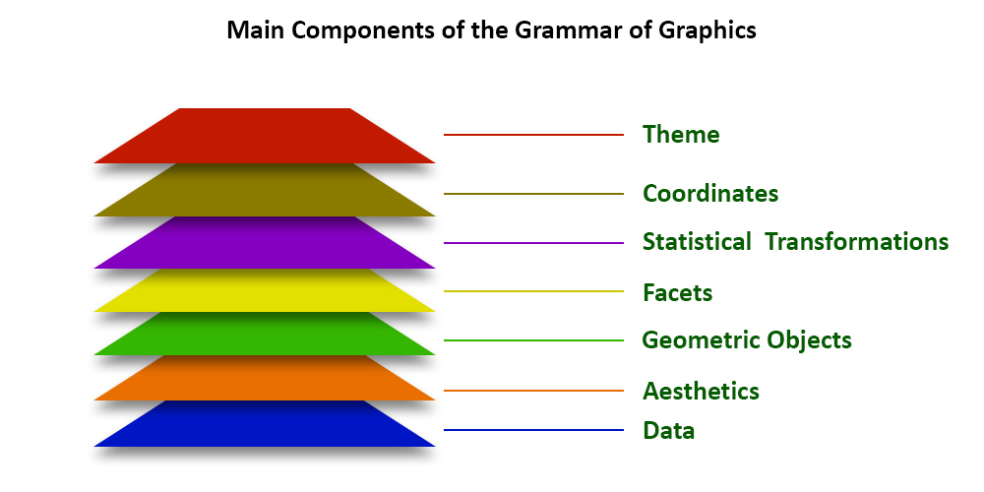
ggplot2 package in R Programming Language also termed as Grammar of Graphics is a free, open-source, and easy-to-use visualization package widely used in R. It is the most powerful visualization package written by Hadley Wickham.
It includes several layers on which it is governed. The layers are as follows:
Building Blocks of layers with the grammar of graphics
Data: The element is the data set itself
Aesthetics: The data is to map onto the Aesthetics attributes such as x-axis, y-axis, color, fill, size, labels, alpha, shape, line width, line type
Geometrics: How our data being displayed using point, line, histogram, bar, boxplot
Facets: It displays the subset of the data using Columns and rows
Statistics: Binning, smoothing, descriptive, intermediate
Coordinates: the space between data and display using Cartesian, fixed, polar, limits
Themes: Non-data link

Slide 11
https://www.geeksforgeeks.org/data-visualization-with-r-and-ggplot2/

Slide 12
Regression analysis is a statistical tool to estimate the relationship between two or more variables. There is always one response variable and one or more predictor variables. Regression analysis is widely used to fit the data accordingly and further, predicting the data for forecasting.
Types of Regression in R
There are mainly three types of Regression in R programming that is widely used. They are:
Linear Regression
Multiple Regression
Logistic Regression

Slide 13
Linear Regression
In linear regression, the relationship is estimated between two variables i.e., one response variable and one predictor variable. Linear regression produces a straight line on the graph. Mathematically
y = ax + b
x indicates predictor or independent variable
y indicates response or dependent variable
a and b are coefficients
In R programming, lm() function is used to create linear regression model.
Syntax: lm(formula)
Parameter:
formula: represents the formula on which data has to be fitted To know about more optional parameters, use below command in console: help(“lm”)

Slide 14
# Height vector
x <- c(153, 169, 140, 186, 128,
136, 178, 163, 152, 133)
# Weight vector
y <- c(64, 81, 58, 91, 47, 57,
75, 72, 62, 49)
#create a linear regression model
model <- lm(y~x)
# Print regression model
print(model)
# Find the weight of a person
# With height 182
df <- data.frame(x = 182)
res <- predict(model, df)
cat("\nPredicted value of a person with height = 182")
print(res)
# Output to be present as PNG file
png(file = "linearRegGFG.png")
# Plot
plot(x, y, main = "Height vs Weight Regression model")
abline(lm(y~x))
# Save the file.
dev.off()

Slide 15
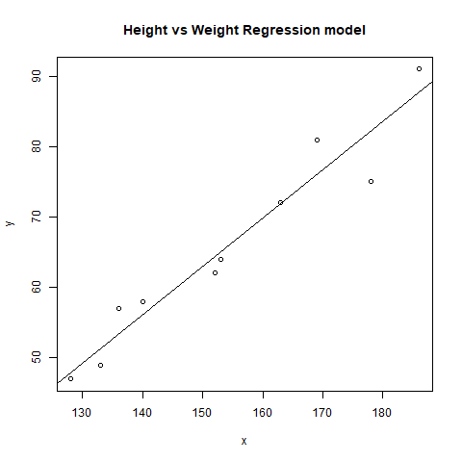
Call: lm(formula = y ~ x)
Coefficients: (Intercept) x -39.7137 0.6847 P
redicted value of a person with height = 182 1 84.9098

Slide 16
Multiple Regression
Multiple regression is another type of regression analysis technique that is an extension of the linear regression model as it uses more than one predictor variables to create the model. Mathematically,
y = a + x_1 * b_1 + x_2 * b_2 + ..... + x_n * b_n
Multiple regression in R programming uses the same lm() function to create the model.
Syntax: lm(formula, data)
formula: represents the formula on which data has to be fitted
data: represents dataframe on which formula has to be applied

Slide 17
Example: Let us create a multiple regression model of air quality dataset present in R base package and plot the model on the graph.
# R program to illustrate
# Multiple Linear Regression
# Using airquality dataset
input <- airquality[1:50,
c("Ozone", "Wind", "Temp")]
# Create regression model
model <- lm(Ozone~Wind + Temp,
data = input)
# Print the regression model
cat("Regression model:\n")
print(model)
# Output to be present as PNG file
png(file = "multipleRegGFG.png")
# Plot
plot(model)
# Save the file.
dev.off()
Output:
Regression model:
Call:
lm(formula = Ozone ~ Wind + Temp, data = input)
Coefficients:
(Intercept) Wind Temp
-58.239 -0.739 1.329

Slide 18
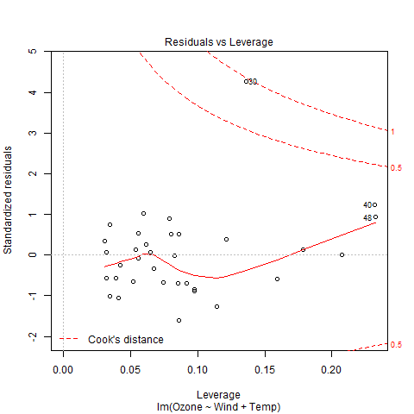

Slide 19
Logistic Regression
Logistic Regression is another widely used regression analysis technique and predicts the value with a range. Moreover, it is used for predicting the values for categorical data. For example, Email is either spam or non-spam, winner or loser, male or female, etc. Mathematically,
y=\frac{1}{1+e^{-z}}
where,
y represents response variable
z represents equation of independent variables or features
In R programming, glm() function is used to create a logistic regression model.
Syntax: glm(formula, data, family)
Parameters:
formula: represents a formula on the basis of which model has to be fitted
data: represents dataframe on which formula has to be applied
family: represents the type of function to be used. “binomial” for logistic regression

Slide 20
# R program to illustrate
# Logistic Regression
# Using mtcars dataset
# To create the logistic model
model <- glm(formula = vs ~ wt, family = binomial, data = mtcars)
# Creating a range of wt values
x <- seq(min(mtcars$wt), max(mtcars$wt), 0.01)
# Predict using weight
y <- predict(model, list(wt = x), type = "response")
# Print model
print(model)
# Output to be present as PNG file
png(file = "LogRegGFG.png")
# Plot
plot(mtcars$wt, mtcars$vs, pch = 16, xlab = "Weight", ylab = "VS")
lines(x, y)
# Saving the file
dev.off()

Slide 21
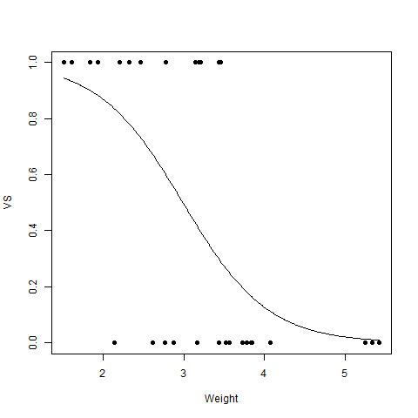
Call: glm(formula = vs ~ wt, family = binomial, data = mtcars)
Coefficients:
(Intercept) wt
5.715 -1.911
Degrees of Freedom: 31 Total (i.e. Null); 30 Residual
Null Deviance: 43.86
Residual Deviance: 31.37 AIC: 35.37

Slide 22
A Poisson Regression model is used to model count data and model response variables (Y-values) that are counts. It shows which X-values work on the Y-value and more categorically, it counts data: discrete data with non-negative integer values that count something.
Mathematical Equation:
log(y) = a + b1x1 + b2x2 + bnxn.....
Parameters:
y: This parameter sets as a response variable.
a and b: The parameter a and b are the numeric coefficients.
x: This parameter is the predictor variable.
The function used to create the Poisson regression model is the glm() function.
Syntax: glm(formula, data, family)
Parameters:
formula: This parameter is the symbol presenting the relationship between the variables.
data: The parameter is the data set giving the values of these variables.
family: This parameter R object to specify the details of the model. It’s value is ‘Poisson’ for Logistic Regression.

Slide 23
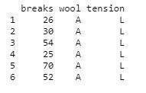
Example:
Approach:
To understand how we can create:
We use the data set “warpbreaks”.
Considering “breaks” as the response variable.
The wool “type” and “tension” are taken as predictor variables.
Code:
input <- warpbreaks
print(head(input))

Slide 24
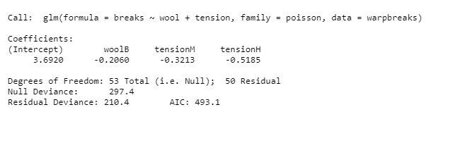
Creating Poisson Regression Model using glm() function
Approach: Creating the regression model with the help of the glm() function as:
With the help of this function, easy to make model.
Now we draw a graph for the relation between “formula”, “data” and “family”.
Example:
output_result <-glm(formula = breaks ~ wool + tension, data = warpbreaks, family = poisson)
output_result
Output:

